Slide 1











Thanksgiving Window
Display
Hayleigh, Jessie, Shina

Slide 2

Theme
Setting: Semi Realistic
Cross mix
IDEA ORIENTED
thanksgiving/fall (leaves, pumpkins, sign)
Snoopy’s thanksgiving (inspo pics)
Pilgrim hats on mannequins (w/ product)
Pyramid
3 mannequins w/ product (sweaters, scarves)
Tallest in middle
Interactive
Customers guess how many pieces of fake popcorn and winner gets a free box of popcorn

Slide 3
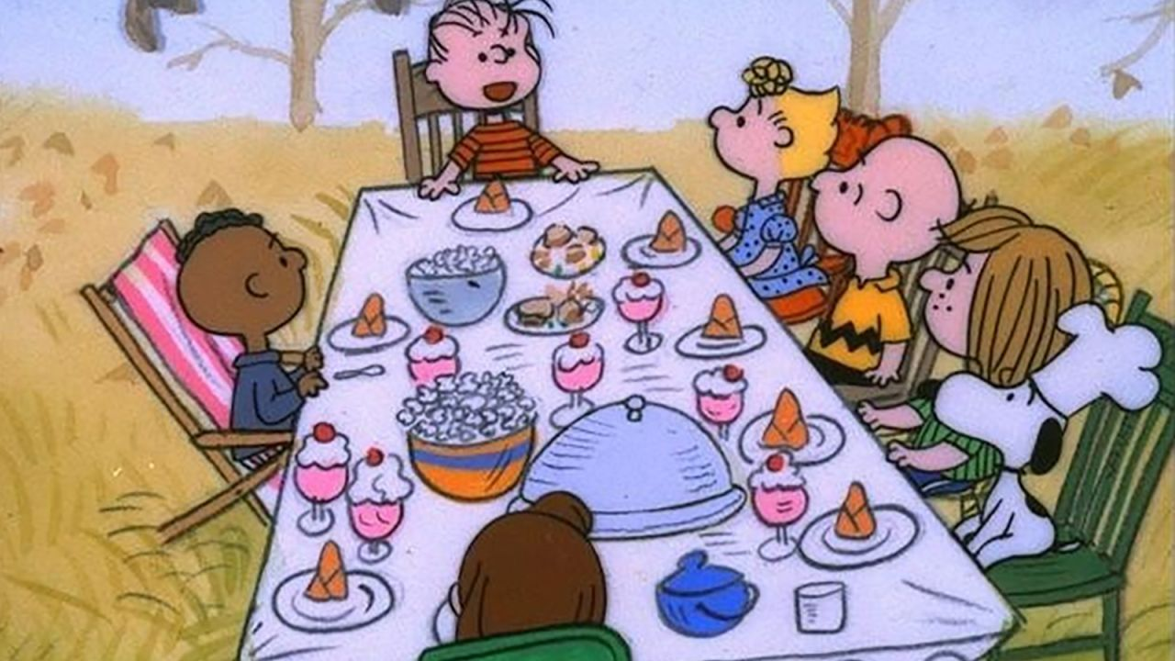
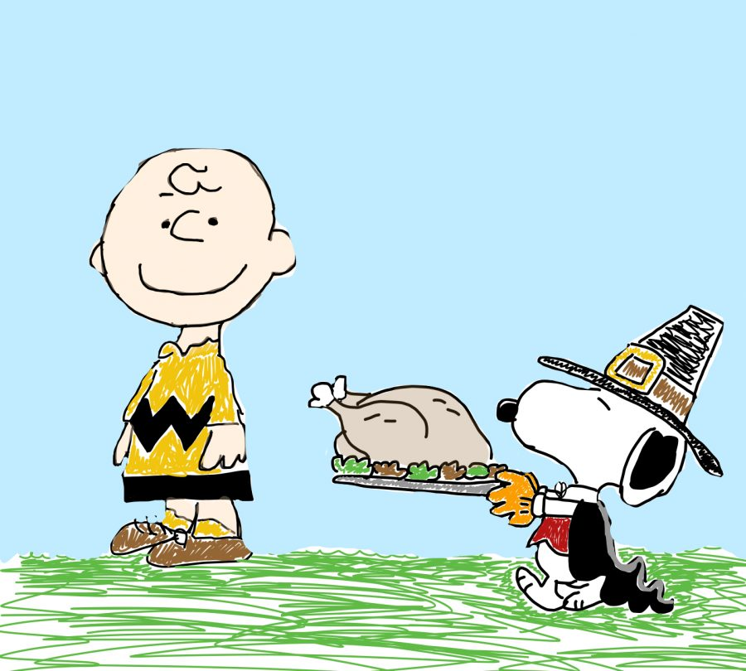

Inspo

Slide 4

Budget
Supplies
Fake popcorn
Fake jelly beans
Snoopy, charlie brown, and woodstock stuffed animals
Pilgrim hats (3)
Where to Buy
Amazon
Etsy- glam candy boutique
Ebay
Amazon
Cost
$18
$3 + $5 delivery
$25
$6/hat ($18)
TOTAL: $69

Slide 5
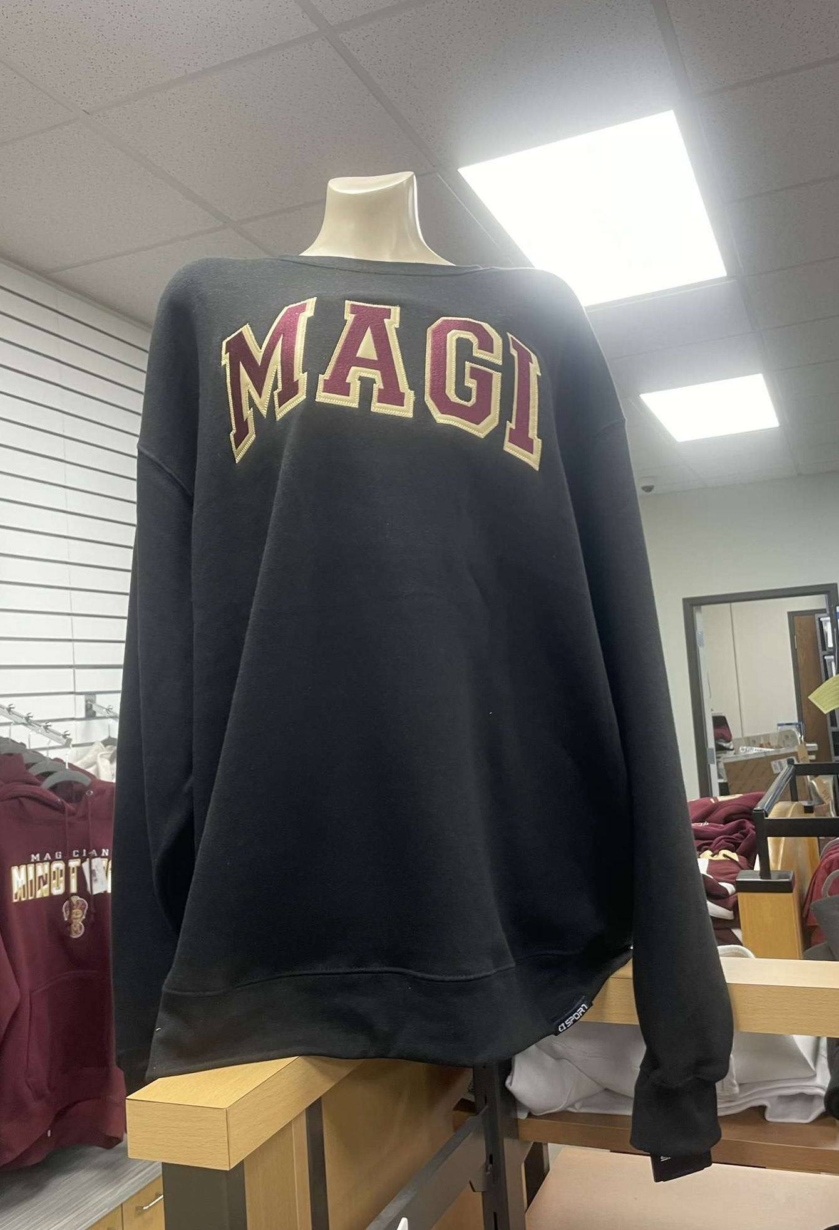
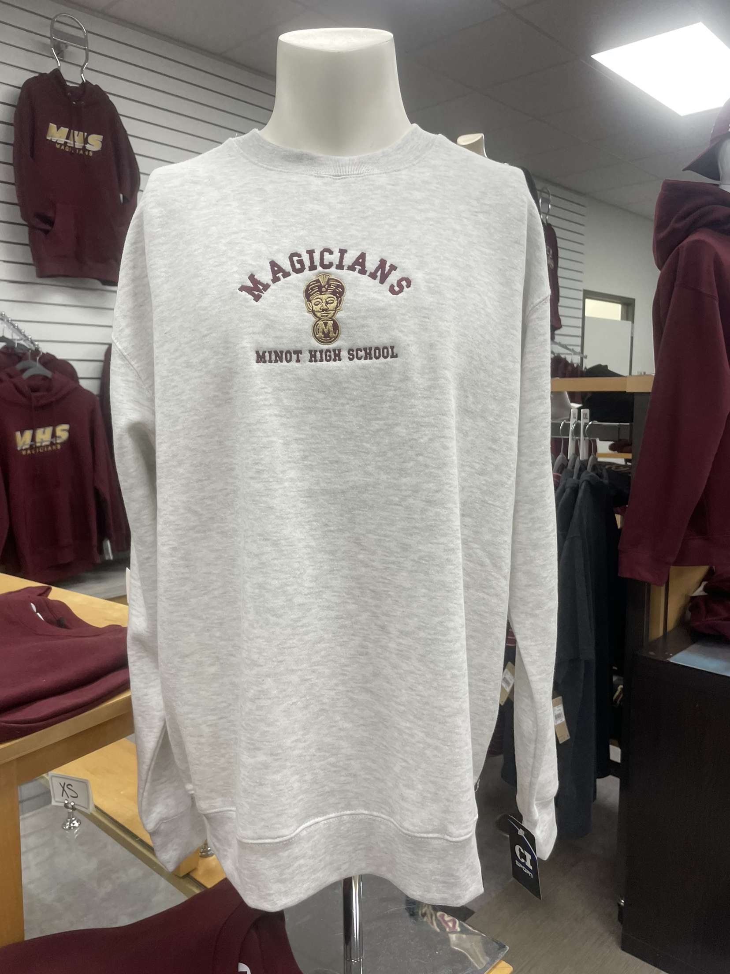

Merchandise

Slide 6
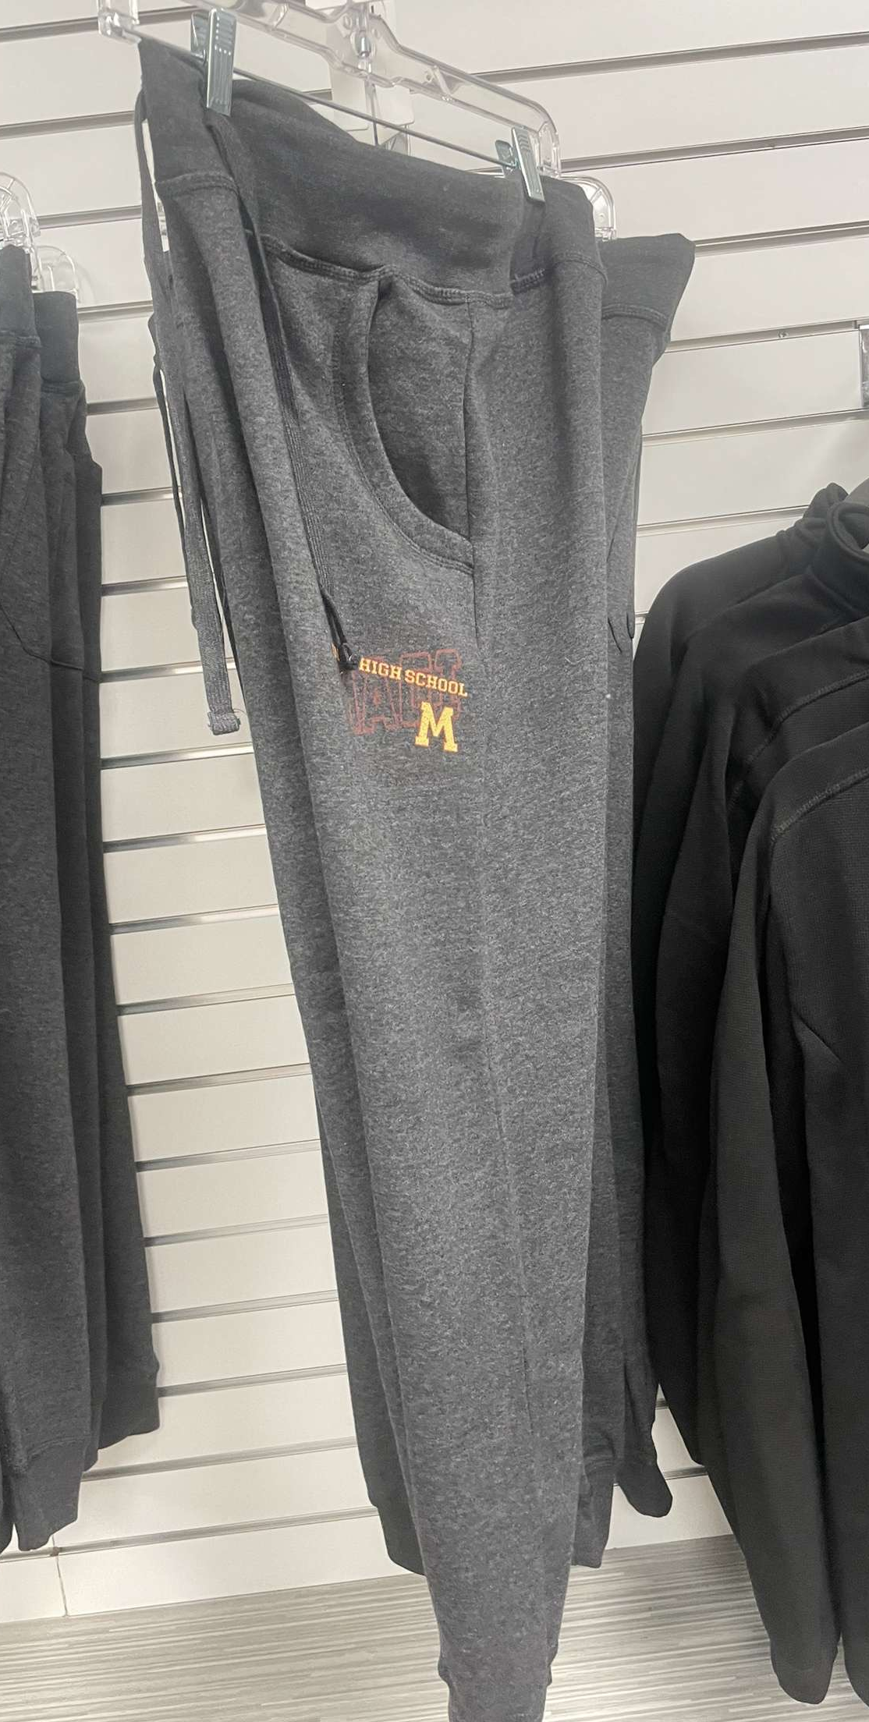
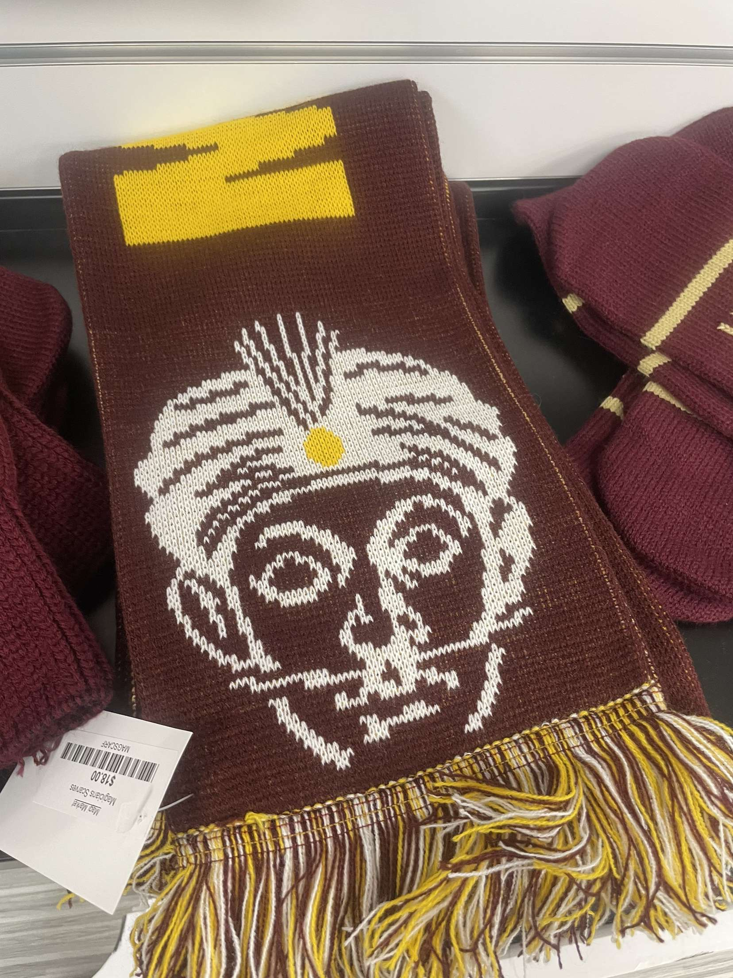
Merchandise

Slide 7
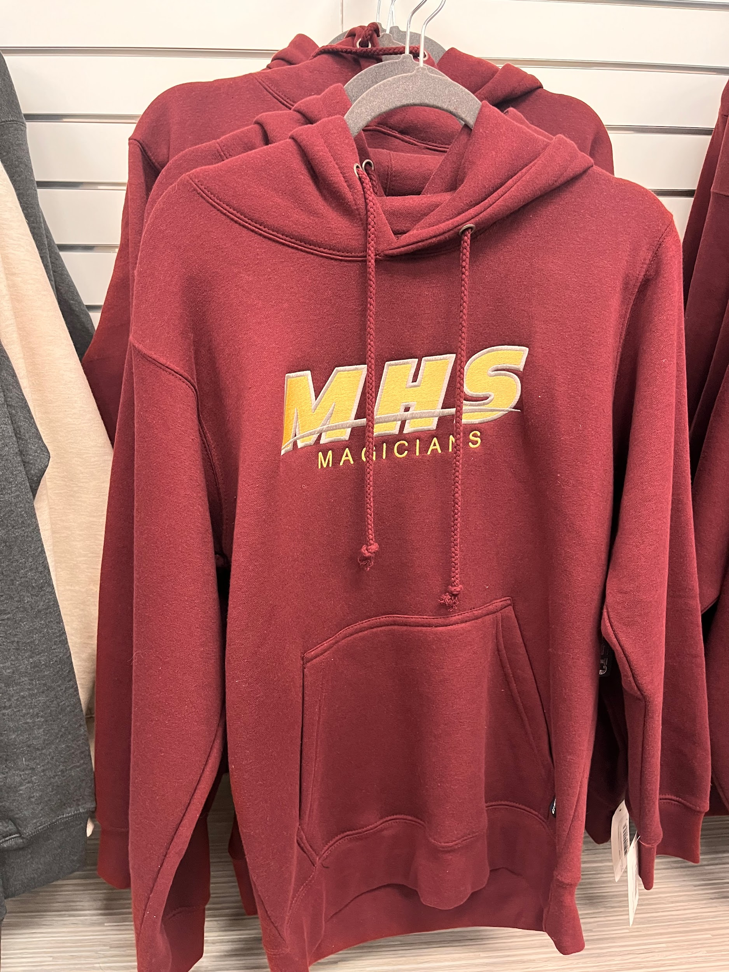
Merchandise

